Slide 1



GOVERNMENT OF KARNATAKA
DEPARTMENT OF COLLEGIATE TECHNICAL EDUCATION
GOVERNMENT ENGINEERING COLLEGE TALAKAL,KOPPAL-583238
DEPARTMENT OF COMPUTER SCIENCE & ENGINEERING
PROJECT ON
“BIDDING APP ON IPL AUCTION”
Under the guidance of:
Presented by:
DYAMMAVA 2LG21CS008
ERAMMA 2LG21CS009
H.RADHIKA 2LG21CS015
KALEENA 2LG21CS016

Slide 2
CONTENTS
Abstract
Introduction
Existing & Proposed System
Methodology
Requirement Specifications
Advantages & Disadvantages
Applications
Results
Future Scope
Conclusion

Slide 3
ABSTRACT
The IPL Bidding App (Admin Panel) is a web-based platform developed to facilitate efficient and transparent management of player auctions and team compositions in an (IPL)-style tournament.
This admin module enables authorized users to create, edit, and manage team profiles, register players, and oversee the bidding process in real time
Key features include player registration with performance stats, team budget allocation, live bid tracking, bid validation, and post-auction team analysis.

Slide 4
INTRODUCTION
The bidding app for IPL cricket management is a powerful platform designed to streamline the auction and team-building process for franchise-based cricket tournaments.
It enables organizers, team owners, and administrators to manage player auctions in a structured, transparent, and real-time environment.
The app allows administrators to set up player profiles with key details such as base prices, roles (batsman, bowler, all-rounder, wicketkeeper), and performance stats.

Slide 5
EXISTING & PROPOSED SYSTEM
In the existing system of the IPL bidding app, the admin has control over team and player management.
The proposed system aims to allows full control over team creation, player registration, and management.
The admin will be able to add, edit, or remove players and teams, set bidding parameters, monitor live bidding activity, and generate reports efficiently
The main features such as real-time updates, automated validation and a user-friendly interface.

Slide 6
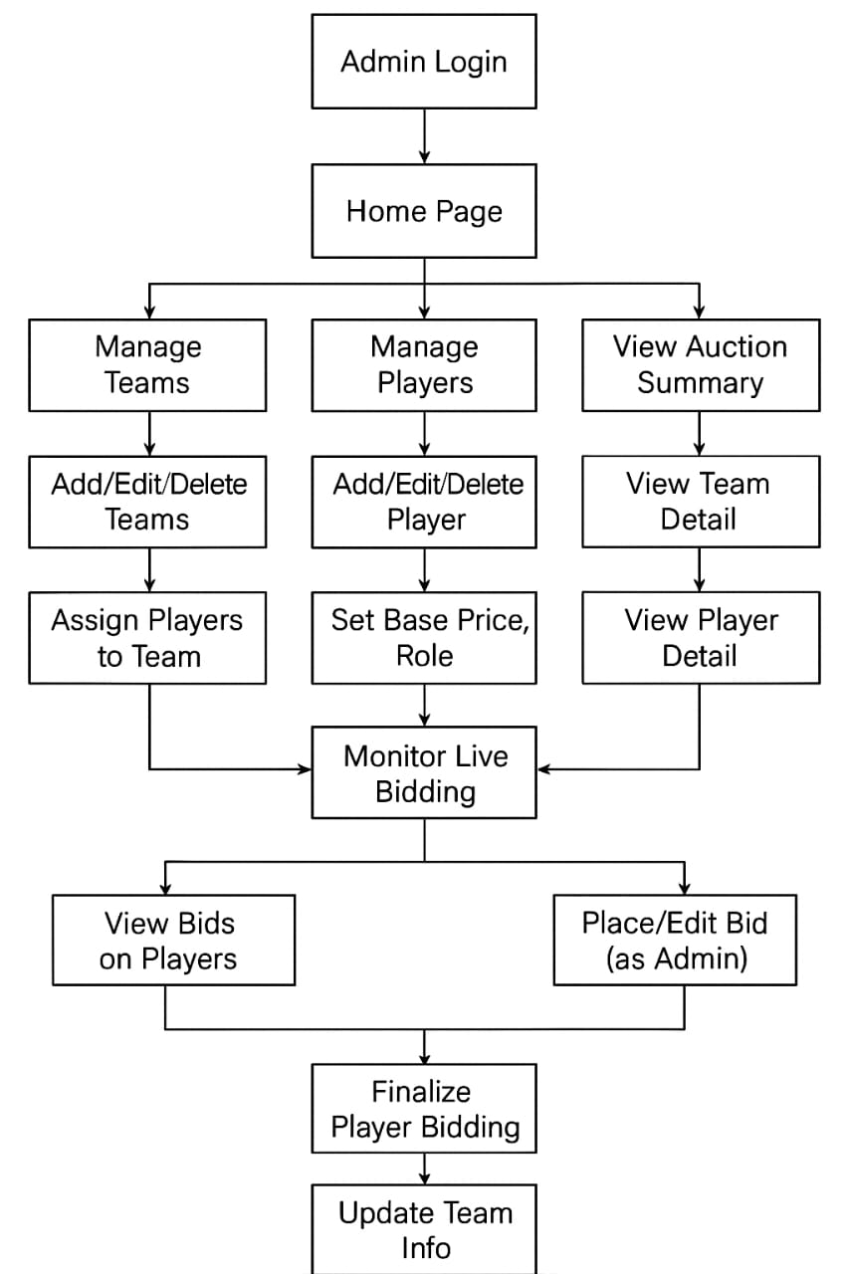
METHODOLOGY

Slide 7
REQUIREMENT SPECIFICATIONS
SOFTWARE REQUIREMENTS
Operating System : Windows 10 or above
Programming Language : Java
Software : Visual Studio
Database : MYSQL
Web Framework : Spring boot

Slide 8
HARDWARE REQUIREMENTS
Processor : Intel Corei5
Input devices : Keyboard, Mouse
Output devices : Monitor (1366x768 Resolution)
RAM : 16.00GB

Slide 9
ADVANTAGES
Centralized Control
Real-Time Bidding Management
Budget and Player Management
Easy Player Management
Data Analytics and Reportings
Customizable Settings

Slide 10
DISADVANTAGES
Complexity in Management
Data Integrity Issues
Scalability Problems
Security Risks

Slide 11
APPLICATIONS
Admin Authentication
Team Management
Player Management
Auction/Bidding Control
Auction Monitoring
Reports & Analytics

Slide 12
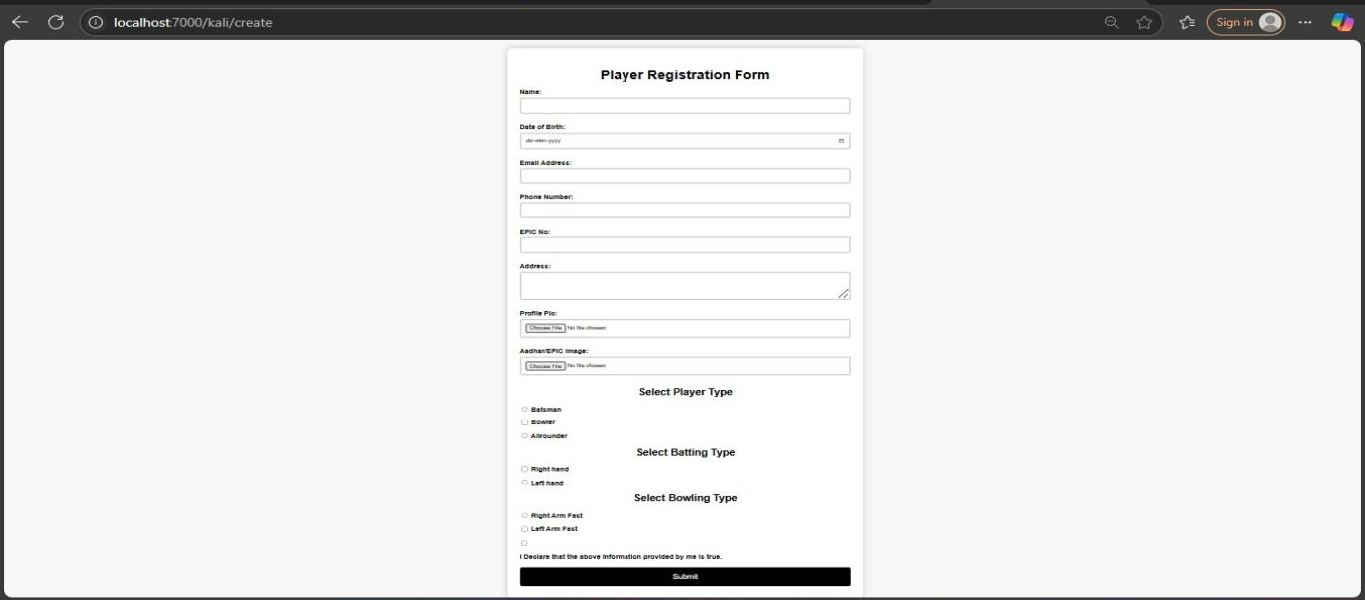
RESULTS
Fig 1: Player Registration Page

Slide 13
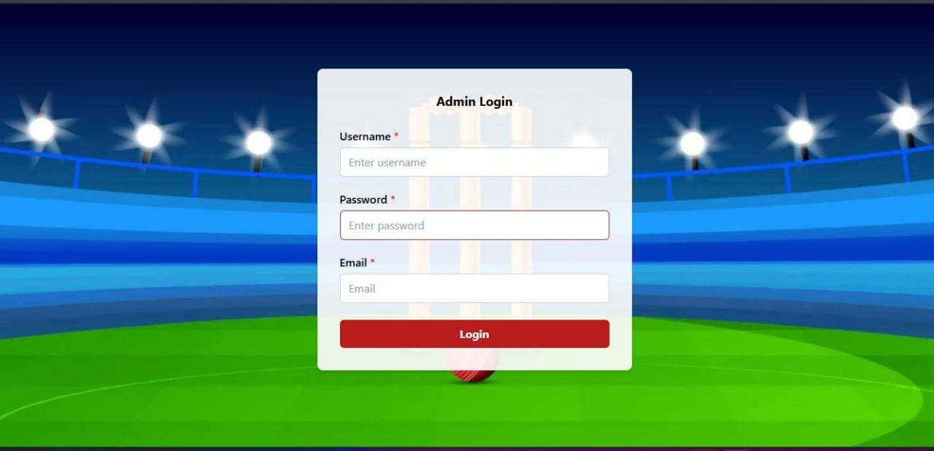
Fig 2: Admin Login

Slide 14
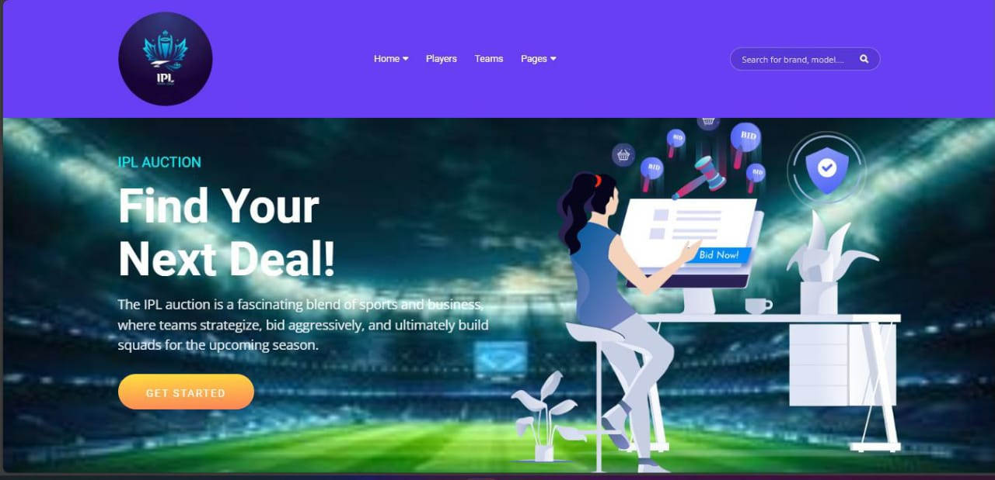
Fig 3:Home Page

Slide 15
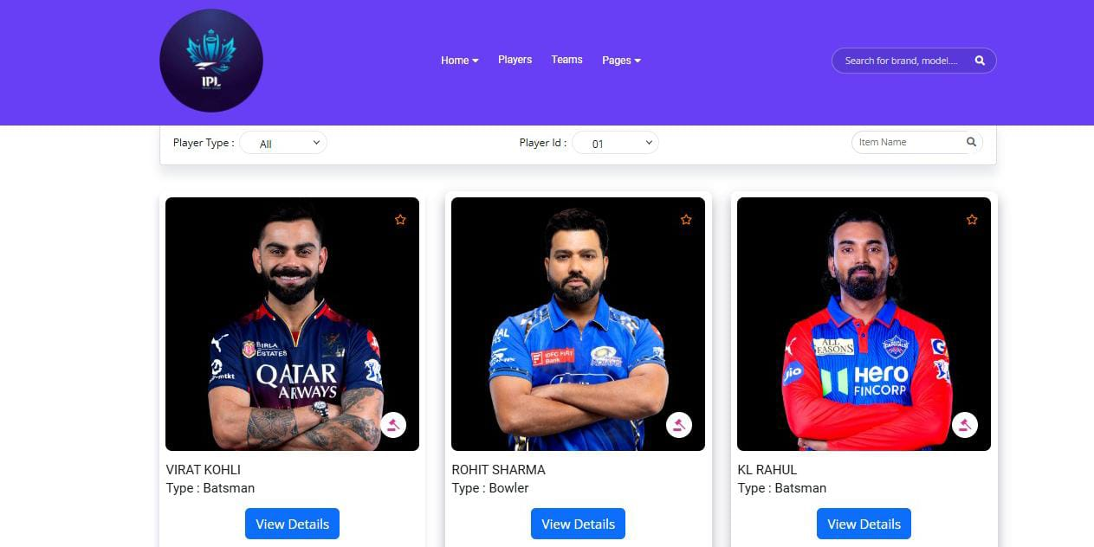
Fig 4:Players List

Slide 16
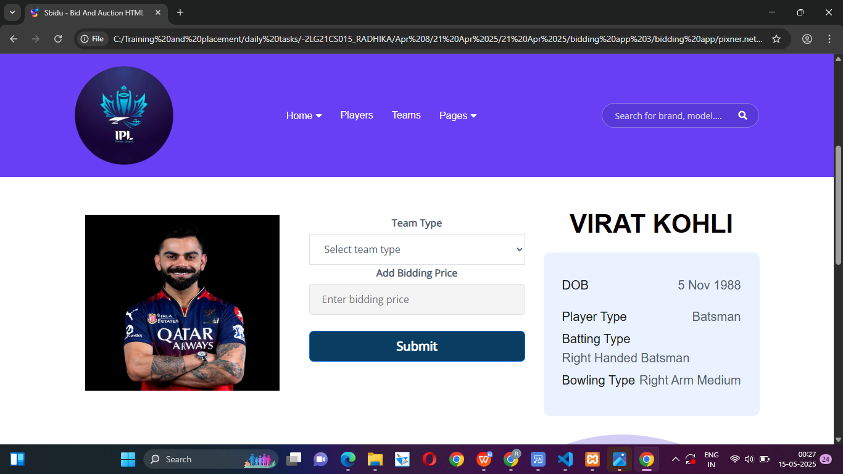
Fig 5:Player Detail

Slide 17
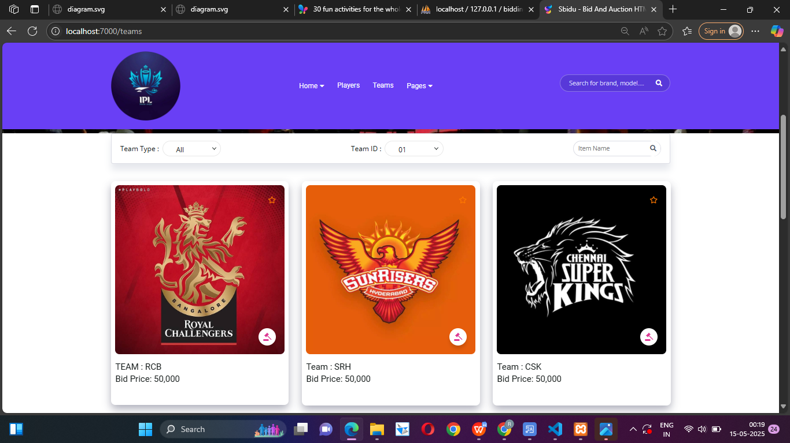
Fig 6: Team list

Slide 18
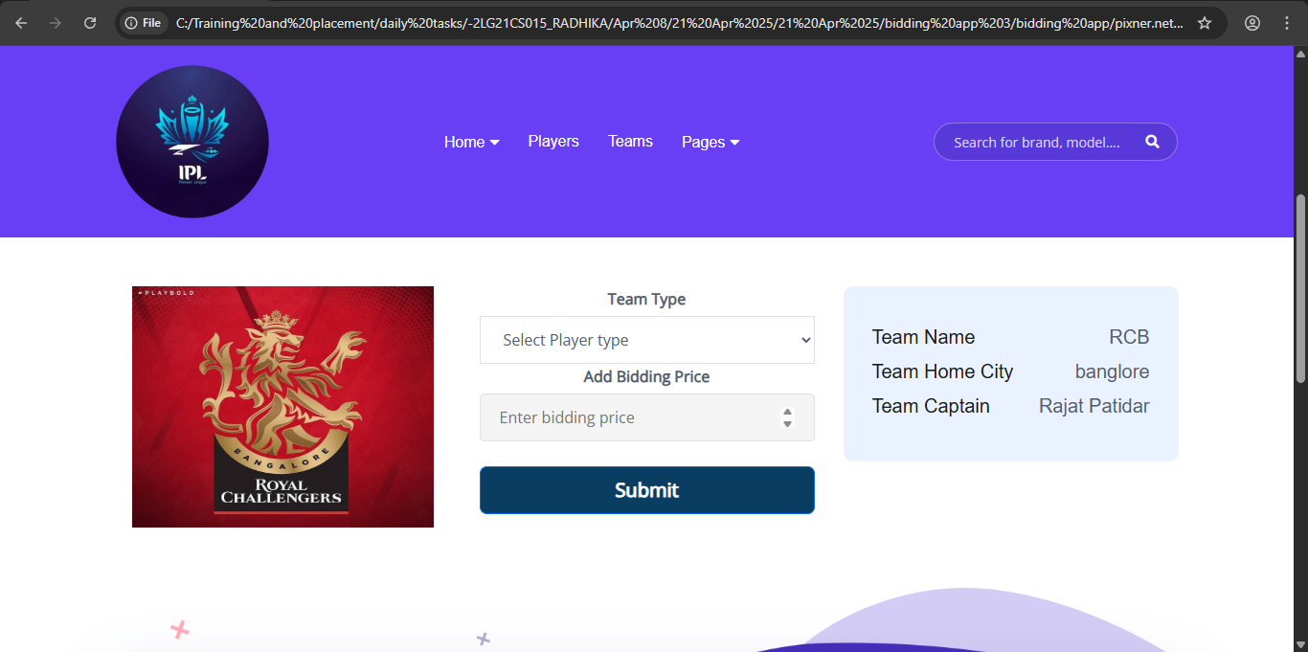
Fig 7:Team Detail

Slide 19
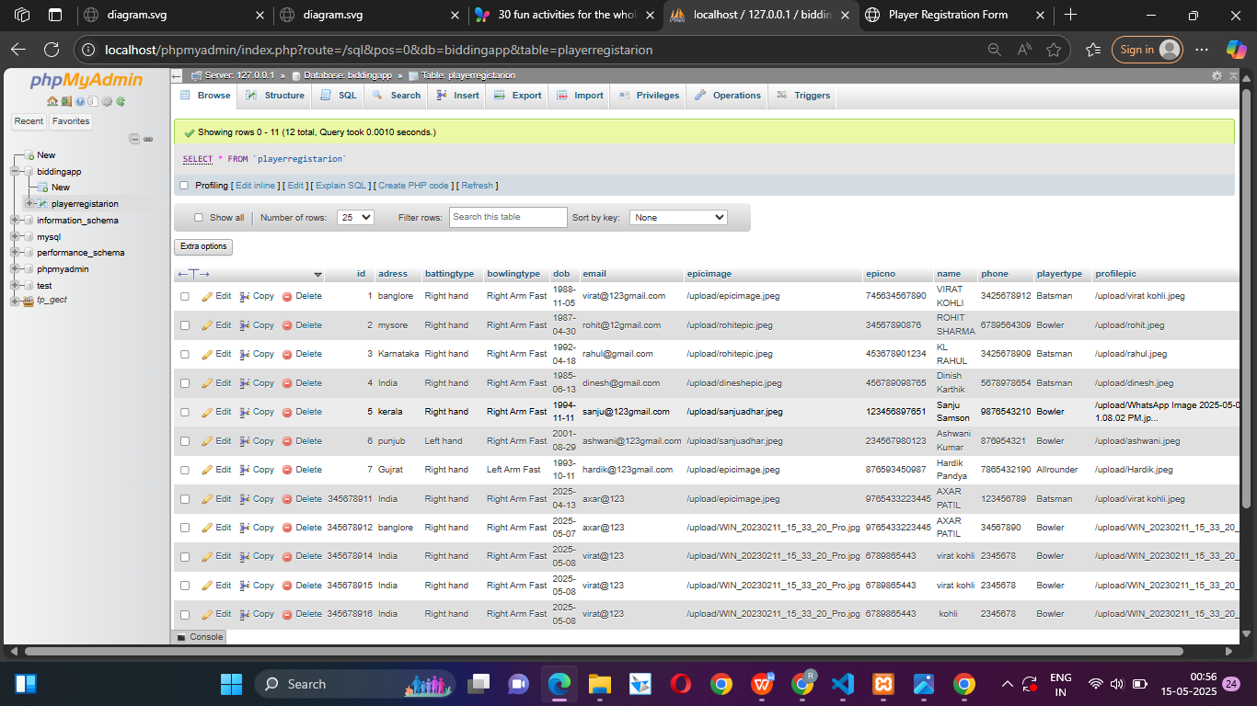
Fig 8: Database

Slide 20
FUTURE SCOPE
The bidding app can become much more advanced and helpful in coming years
It could allow admins to easily handle team budgets, choose players, and plan strategies using real-time data and smart suggestions.
The app can also support other cricket leagues and even custom tournaments. Features like live auctions, player performance tracking and role-based access can make the process faster and more organized.
It could also include tools to create reports, show team and player stats clearly.

Slide 21
CONCLUSION
The system provides a complete environment where administrators can control the flow of the auction, add players, set rules, and monitor team budgets, while team owners can actively participate in live bidding with ease.
With features such as player registration, player listing, bidding control, budget tracking, and real-time updates.
By providing centrathe application enhances efficiency, reduces manual errors, and maintains the integrity of the bidding process.

Slide 22
THANK YOU

